Slide 1
Shell scripting
By vishal pimple

Slide 2
What is shell scripting
shell script is a list of commands in a computer program that is run by the Unix shell which is a command line interpreter. A shell script usually has comments that describe the steps.
*Types of shell
1 Bourne Shell
2. C Shell
3. Korn Shel
4. Bourne Again shell (bash)

Slide 3
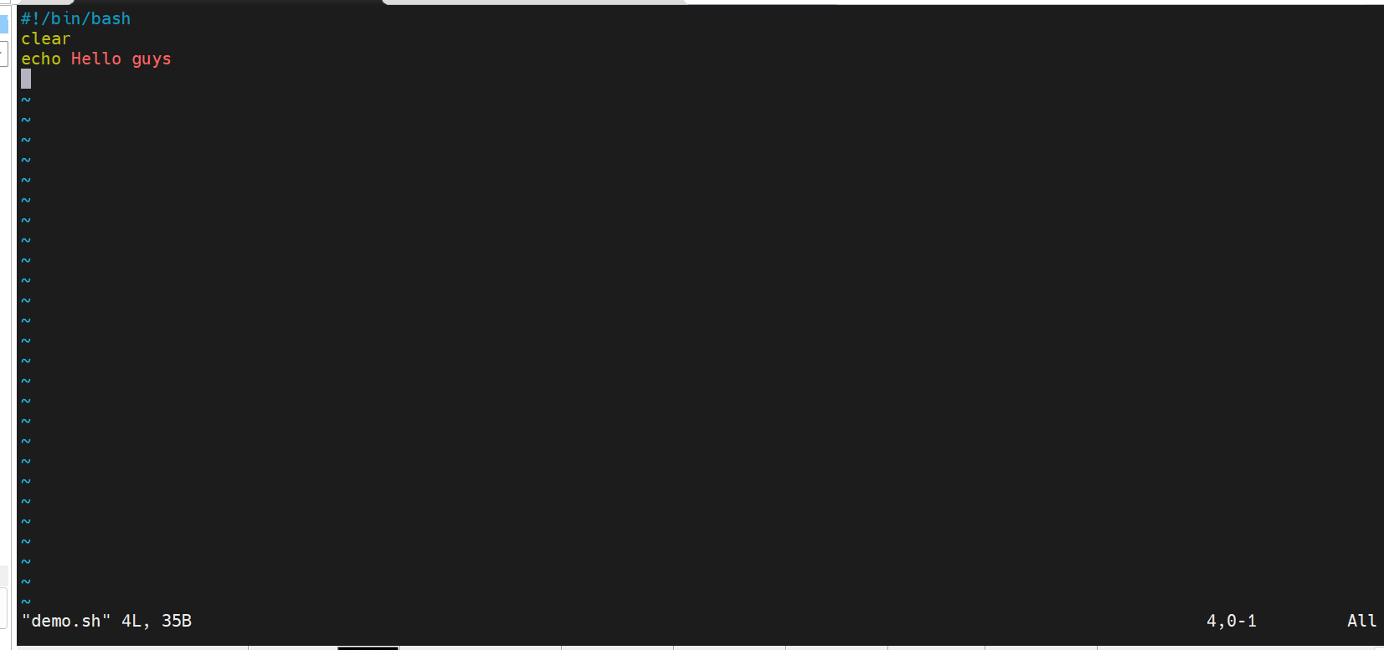
Basic shell program

Slide 4
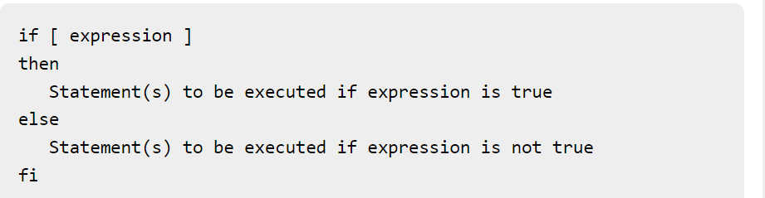
Conditional statement
The if...else...fi statement is the next form of control statement that allows Shell to execute statements in a controlled way and make the right choice.

Slide 5
Loop control
For loop
Ex syntax
For I in 1 2 3 4
do
echo $I
done

Slide 6
Loop control
While loop
While [ $a –lt 10 ]
do
echo $a
a=a+1;
done

Slide 7
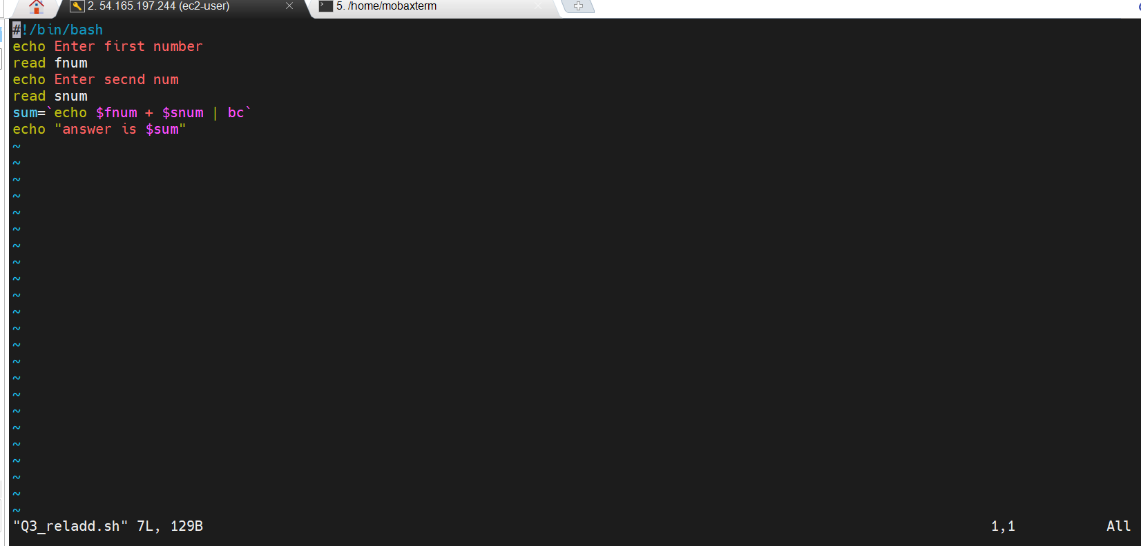
Addition program

Slide 8
Relational operators
$-eq :Checks if the value of two operands are equal or not; if yes, then the condition becomes true.
$-ne:Checks if the value of two operands are equal or not; if values are not equal, then the condition becomes true.
$-gt :Checks if the value of left operand is greater than the value of right operand; if yes, then the condition becomes true.
$-lt :Checks if the value of left operand is less than the value of right operand; if yes, then the condition becomes true

Slide 9
Logical operators
! :This is logical negation. This inverts a true condition into false and vice versa.
-o :This is logical OR. If one of the operands is true, then the condition becomes true
-a : This is logical AND. If both the operands are true, then the condition becomes true otherwise false.

